Slide 1
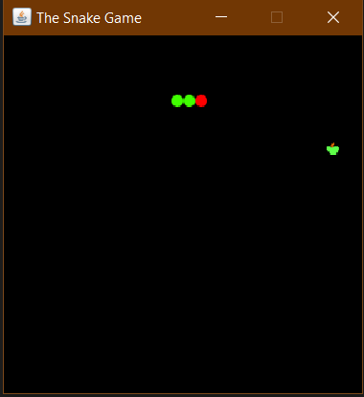
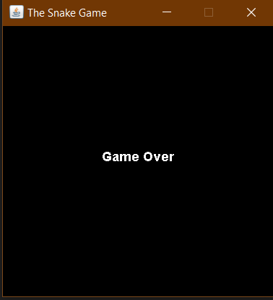

The Snake Feeding Game

Slide 2
Project Specification
The Player Controls a dot, Square or Object on a borderd Plane
As it moves forward it leaves a trail behind resembling a moving Snake
The Player loses when the snake runs into the screen border or itself.

Slide 3
What I have learnt from project
Object Oriented Programming In JAVA
Making an application using core java libraries
Learnt core java AWT and SWING uses
Classes and object in JAVA

Slide 4
Steps to create the project
Create a java project in IDE
Adding Images to the project
Start creating frame
Place the image inside the frame
Place the image one behind other
Location of apple
Adding action listeners
Implementing keyboard events
Handeling collison to snake with apple
Handeling collision of the snake with wall or itself
Moving the snake inside the frame
repaint the frame
Handel the Game Over Functionality
Running the snake game
Creating the jar file of the project

Slide 5
THANK YOU

